Slide 1


Robert van Iersel
28-03-2022

Slide 2

Outline
Executive Summary
Introduction
Methodology
Results
Conclusion
Appendix

Slide 3
Executive Summary
Summary of methodologies
Data Collection using API calls
Data Collection through Web Scraping
Data Wrangling / Cleaning
Exploratory Data Analysis through SQL
Exploratory Data Analysis through Data Visualization
Interactive Visual Analytics through Folium
Machine Learning Prediction
Summary of all results
Results of Exploratory Data Analysis
Screenshots of Interactive Analytics shown
Results of Predictive Analytics

Slide 4
Introduction
Project background and context
Space X advertises Falcon 9 rocket launches on its website with a cost of 62 million dollars; other providers cost upward of 165 million dollars each, much of the savings is because Space X can reuse the first stage. Therefore, if we can determine if the first stage will land, we can determine the cost of a launch. This information can be used if an alternate company wants to bid against space X for a rocket launch. This goal of the project is to create a machine learning pipeline to predict if the first stage will land successfully.
Problems you want to find answers
What factors determine if the rocket will land successfully?
The interaction amongst various features that determine the success rate of a successful landing.
What operating conditions needs to be in place to ensure a successful landing program.

Slide 5

Section 1

Slide 6
Methodology
Executive Summary
Data collection methodology:
Describe how data was collected
Perform data wrangling
Describe how data was processed
Perform exploratory data analysis (EDA) using visualization and SQL
Perform interactive visual analytics using Folium and Plotly Dash
Perform predictive analysis using classification models
How to build, tune, evaluate classification models

Slide 7
Data Collection
The data was collected in the following fashion.
First data was gathered using get request to the SpaceX API.
Then, the response was decoded as a Json using the .json() function call and turn it into a pandas dataframe using the .json_normalize() function.
Subsequently the data was cleaned, checked for missing values and missing values were filled in where needed.
Next Falcon 9 launch records were scraped from Wikipedia using BeautifulSoup; the objective was to extract the launch records as HTML table, parse the table and convert it to a pandas dataframe for future analysis.

Slide 8
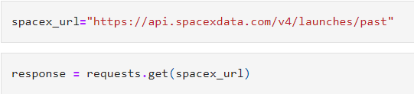
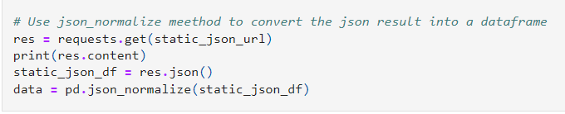
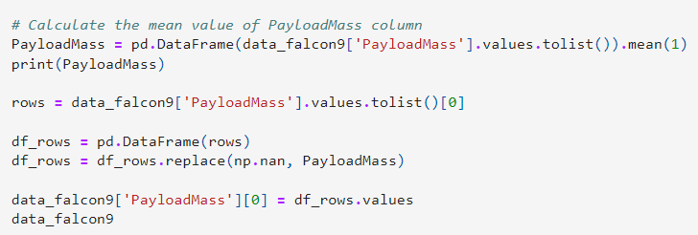
Data Collection – SpaceX API
Data was collected by using the get request to the SpaceX API. Next the data was cleaned, wrangled and formatted.
The link to the notebook is Space_project/Week 1.ipynb at master · Robier55/Space_project (github.com)
Get request collecting launch data using API
Json_normalize method to nor-malize & con-vert into pd df
Data cleaning & filling missing values

Slide 9
Data Collection - Scraping
Applying web scrapping to collect Falcon 9 launch records using BeautifulSoup
Parrsing the table and converted into a pandas dataframe (pd df)
Notebook link: Space_project/Week 1.ipynb at master · Robier55/Space_project (github.com)
Applying HTTP get method to get to the Falcon 9 web page
Creating beutifulsoup object from the HTML response
Getting all column names from the table header
9

Slide 10
Data Wrangling
We performed exploratory data analysis and determined the training labels.
We calculated the number of launches at each site, and the number and occurrence of each orbits
We created landing outcome label from outcome column and exported the results to csv.
The link to the notebook is Space_project/Data wrangling.ipynb at master · Robier55/Space_project (github.com)

Slide 11
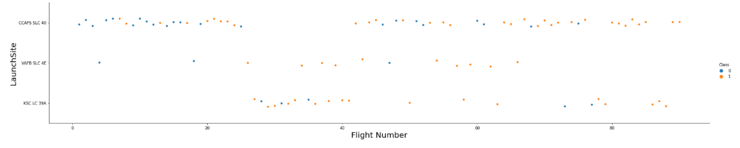
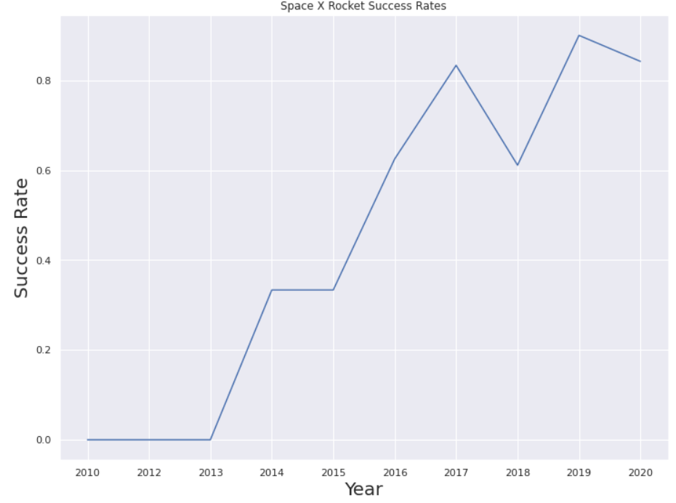
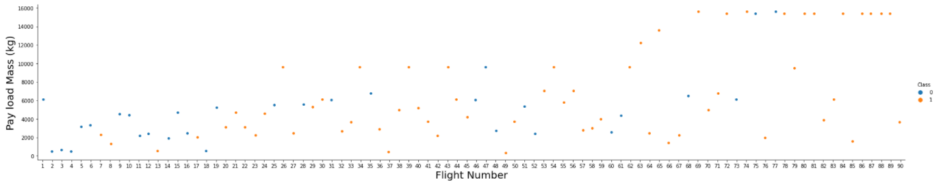
EDA with Data Visualization
The relationship between flight number and launch and between payload and launch sitewas studies using visualization.
Furthermore the success rate of each orbit type, flight number and orbit type and the launch success yearly trend.
Note book: Space_project/Viz2.ipynb at master · Robier55/Space_project (github.com)

Slide 12
EDA with SQL
SpaceX dataset was loaded into a PostgreSQL database from a jupyter notebook.
Applying EDA with SQL to get insight from the data.
Queries were applied to gather insights like:
Names of the unique launch sites.
The total payload mass carried by boosters launched by NASA
The average payload mass carried by booster version F9
The total number of successful and failure mission outcomes
The failed landing outcomes in drone ship, their booster version and launch site names.
notebook link: Space_project/Nieuwe poging.ipynb at master · Robier55/Space_project (github.com)

Slide 13
Build an Interactive Map with Folium
By making use of the library Folium all launch site were marked using markers, circles, lines to mark the success or failure of launches
Applying the feature launch failure or success to respectively class 0 and 1.
Using the color-labeled marker clusters, the launch sites with relatively high success rate was identified
And lastly the distances between a launch site to its proximities was calculated e.g. to nearby railways, highways and coastlines.

Slide 14
Build a Dashboard with Plotly Dash
An interactive dashboard was developed using Plotly dash
Using Plotly pie charts were developed to show the total launches by a certain sites
Furthermore, scatter plots were developed showing the relationship with Outcome and Payload Mass (Kg) for the different booster version.

Slide 15
Predictive Analysis (Classification)
Applying numpy and pandas data was loaded and transformed
Furthermore, the data was split into training and testing data.
Next several machine learning models were developed and also tune different hyperparameters using GridSearchCV.
The accuracy of the models was measured (using metrics) and subsequently the model were improved via feature engineering and algorithm tuning.
Finaly the best model was selected.
Notebook link Space_project/Week 4.ipynb at master · Robier55/Space_project (github.com)

Slide 16
Results
Exploratory data analysis results
Interactive analytics demo in screenshots
Predictive analysis results

Slide 17

Section 2

Slide 18
Flight Number vs. Launch Site
The graph shows that the larger the flight amount at a launch site, the greater the success rate at a launch site.

Slide 19
Payload vs. Launch Site
The graph shows that the greater the payload mass (for CCAFS SLC 40) the higher the success rate.

Slide 20
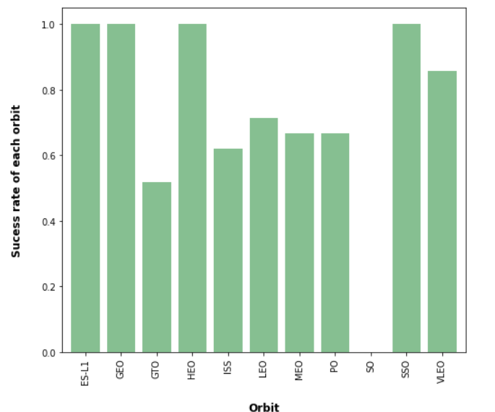
Success Rate vs. Orbit Type
From the bar graph can can immediately be seem what the success rate is of the different sites

Slide 21
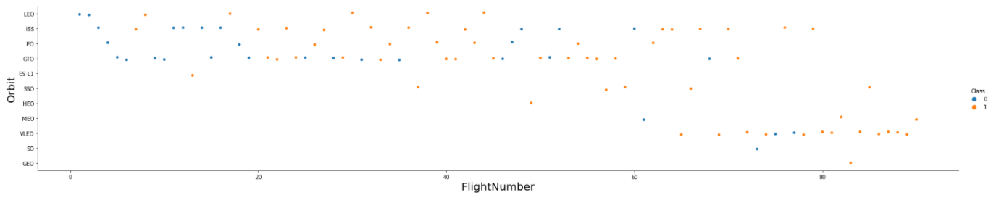
Flight Number vs. Orbit Type
The scatter plot shows the Flight Number vs. Orbit type.
It can be seen that in the LEO orbit, success is related to the number of flights whereas in the GTO orbit, there is no relationship between flight number and the orbit.

Slide 22
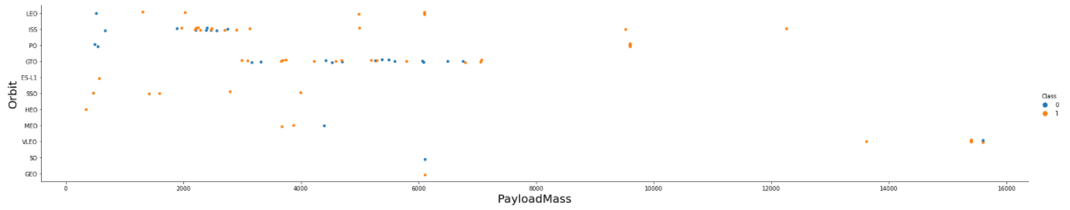
Payload vs. Orbit Type
With heavy payloads, there are more successful landings for the following orbits: PO, LEO and ISS.

Slide 23
Launch Success Yearly Trend
From the plot, we can observe that success rate since 2013 kept on increasing till 2020.

Slide 24
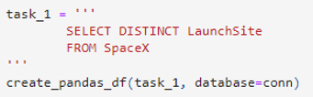
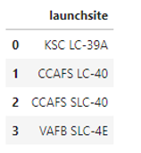
All Launch Site Names
The following query was used to find the names of the sites

Slide 25
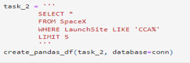
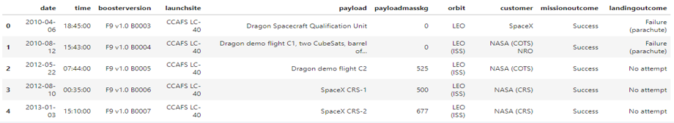
Launch Site Names Begin with 'CCA'
The following query was used to find the launch sites begin with `CCA`

Slide 26
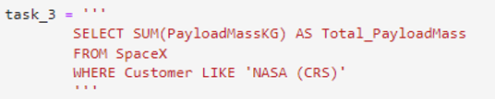
Total Payload Mass
The following query was used to calculate the total payload carried by boosters from NASA
The total payload carried by boosters from NASA: 45596

Slide 27
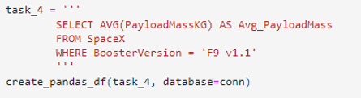
Average Payload Mass by F9 v1.1
The following query was used to calculate the average payload mass carried by booster version F9 v1.1
The calculated average payload mass carried by booster version F9 v1.1: 2928.4

Slide 28
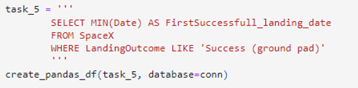
First Successful Ground Landing Date
The following query was used to find the dates of the first successful landing outcome on ground pad
The dates of the first successful landing outcome on ground pad was 22nd December 2015

Slide 29
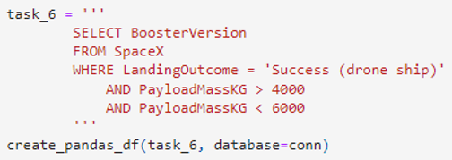
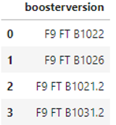
Successful Drone Ship Landing with Payload between 4000 and 6000
The following query was used to list the names of boosters which have successfully landed on drone ship and had payload mass greater than 4000 but less than 6000
Outcome:

Slide 30
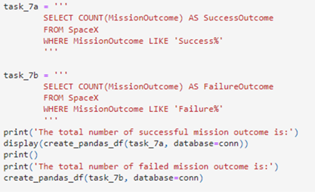
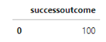
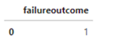
Total Number of Successful and Failure Mission Outcomes
The following query was used to calculate the total number of successful and failure mission outcomes.
Outcome

Slide 31
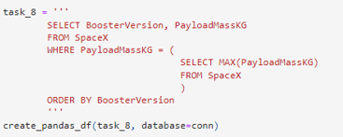
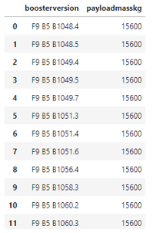
Boosters Carried Maximum Payload
The following query was used to list the names of the booster which have carried the maximum payload mass.
Outcome:

Slide 32
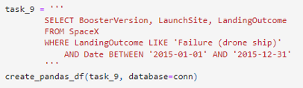
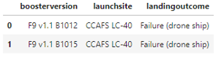
2015 Launch Records
The following query was used to list the failed landing_outcomes in drone ship, their booster versions, and launch site names for in year 2015
Outcome

Slide 33
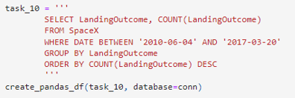
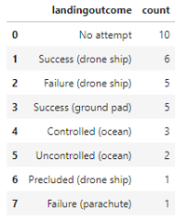
Rank Landing Outcomes Between 2010-06-04 and 2017-03-20
The following query was used to Rank the count of landing outcomes (such as Failure (drone ship) or Success (ground pad)) between the date 2010-06-04 and 2017-03-20, in descending order
Outcome:

Slide 34

Section 3

Slide 35
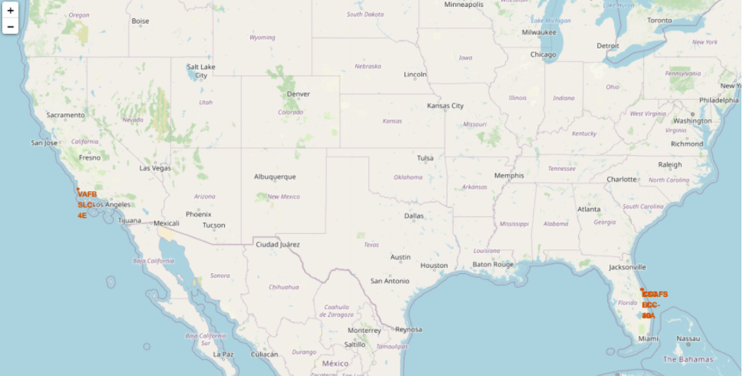
Launch sites on both the east and west coast of the US

Slide 36
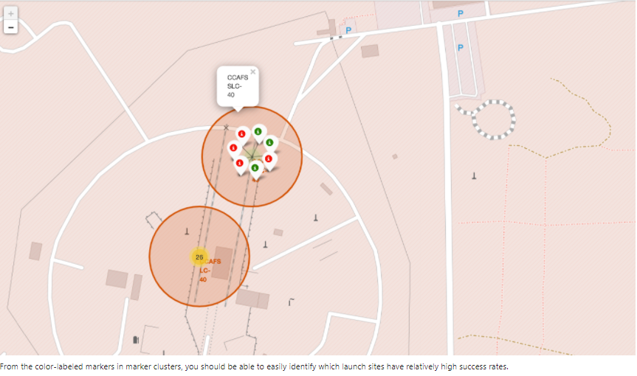
Success rates of the launch site

Slide 37
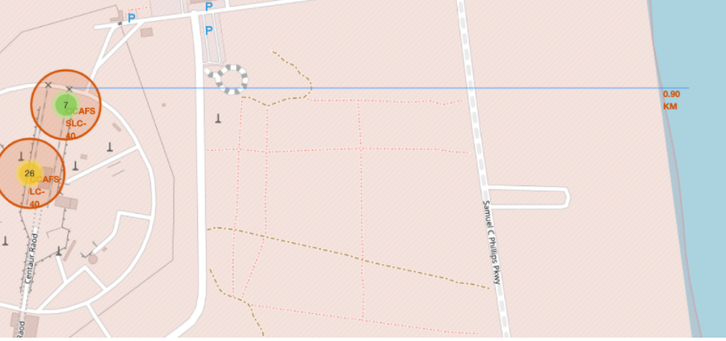
Distance launch site to a point at sea

Slide 38

Section 4

Slide 39
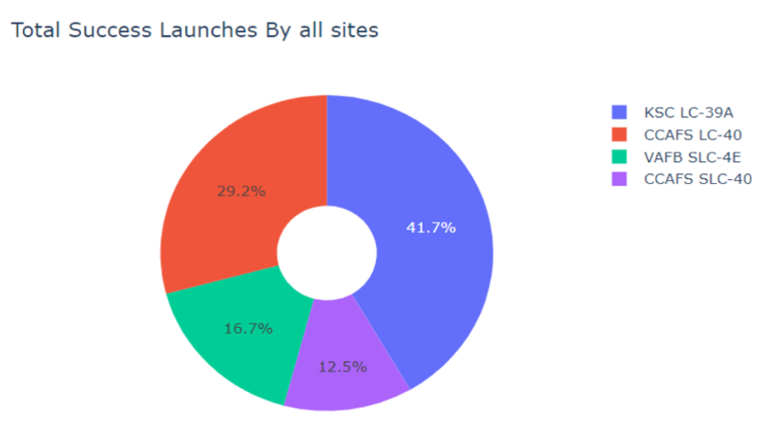
Total successful launches per site

Slide 40
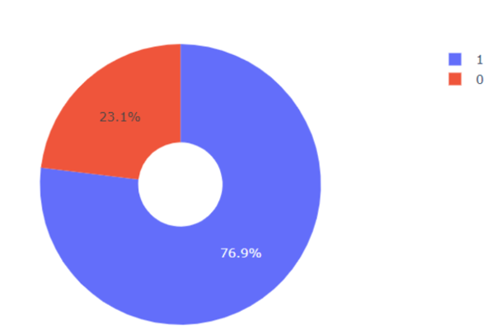
KSC LC-39A is most successful launch site

Slide 41
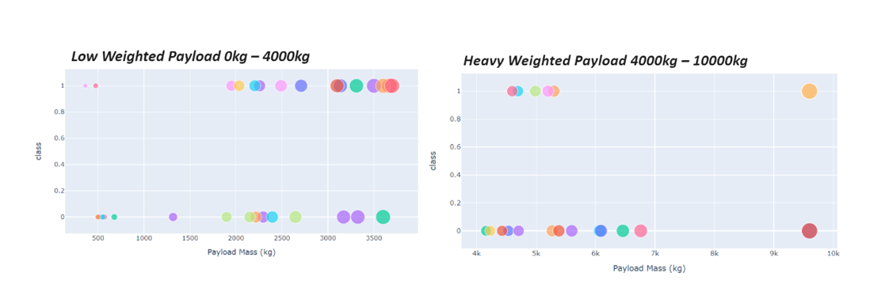
Success rate: high vs low payload weight

Slide 42

Section 5

Slide 43
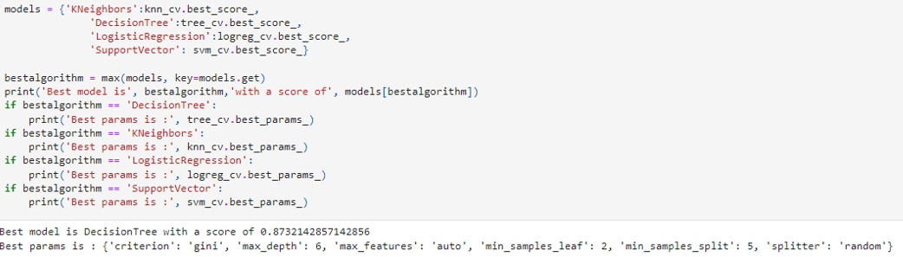
Classification Accuracy

Slide 44

Confusion Matrix
The confusion matrix for the decision tree classifier shows that the classifier can distinguish between the different classes.
The relatively high number of false positives is an issue still

Slide 45
Conclusions
Launch sites become more successful, in terms of launch success rates, when they have more launches (learning effect)
There is an overall learning effect over time i.e. Launch success rate started to increase in 2013 till 2020.
Success rate also depends on the orbit: Orbits ES-L1, GEO, HEO, SSO, VLEO had the highest success rate.
KSC LC-39A had the most successful launches of any sites.
The Decision tree classifier is the best machine learning algorithm for this task.

Slide 46
Appendix
Include any relevant assets like Python code snippets, SQL queries, charts, Notebook outputs, or data sets that you may have created during this project

Slide 47


